Slide 1
Client-Server Communication using Shared Memory

Slide 2
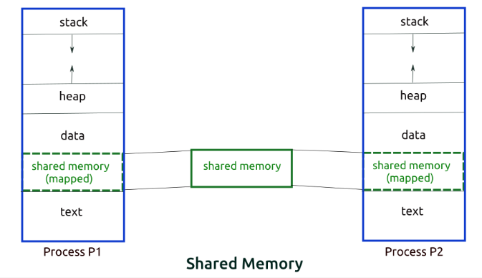
Shared Memory

Slide 3
IPC key
#include <sys/types.h>
#include <sys/ipc.h>
key_t ftok (const char *pathname, int proj_id);
shmget
#include <sys/ipc.h>
#include <sys/shm.h>
int shmget (key_t key, size_t size, int shmflg);

Slide 4
shmat
#include <sys/types.h>
#include <sys/shm.h>
void *shmat (int shmid, const void *shmaddr, int shmflg);
shmdt
#include <sys/types.h>
#include <sys/shm.h>
int shmdt (const void *shmaddr);

Slide 5
